Slide 1
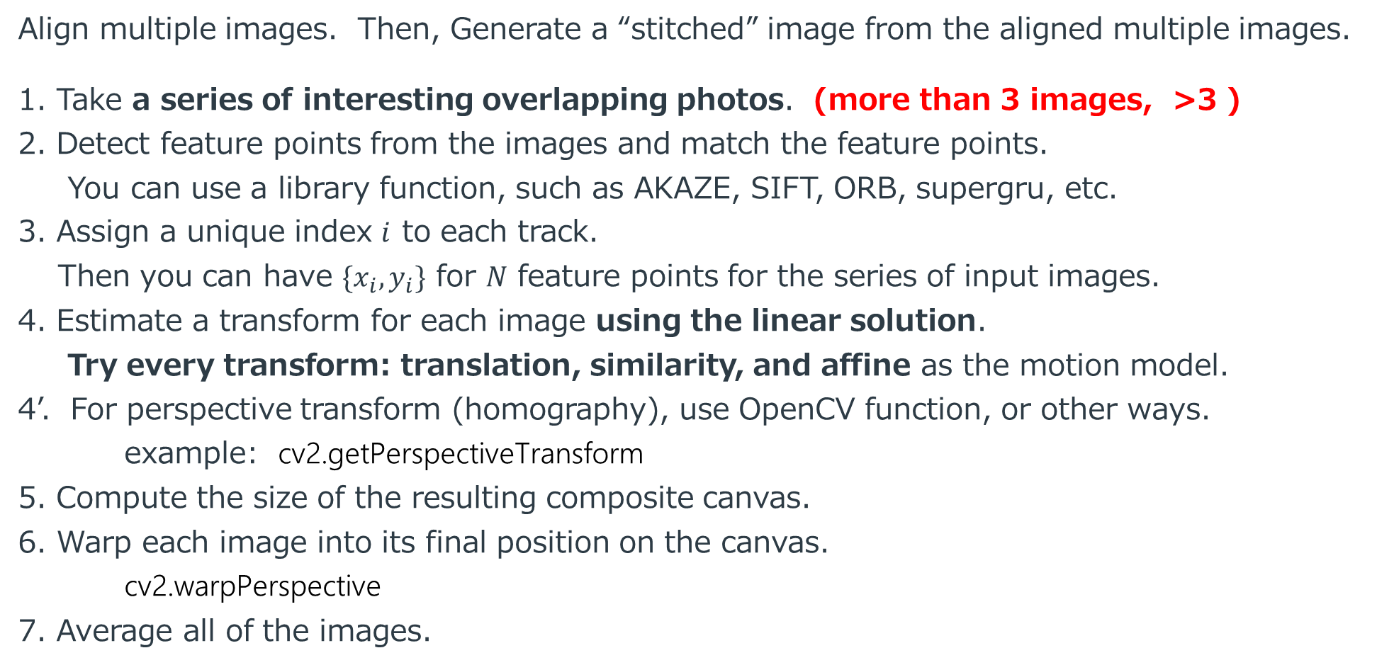
Exercise May 19: Geometric Transform of Image
Align multiple images. Then, Generate a “stitched” image from the aligned multiple images.
1. Take a series of interesting overlapping photos. (more than 3 images, >3 )
2. Detect feature points from the images and match the feature points.
You can use a library function, such as AKAZE, SIFT, ORB, supergru, etc.
3. Assign a unique index $i$ to each track.
Then you can have $\{x_{i}, y_{i}\}$ for $N$ feature points for the series of input images.
4. Estimate a transform for each image using the linear solution.
Try every transform: translation, similarity, and affine as the motion model.
4’. For perspective transform (homography), use OpenCV function, or other ways.
example: cv2.getPerspectiveTransform
5. Compute the size of the resulting composite canvas.
6. Warp each image into its final position on the canvas.
cv2.warpPerspective
7. Average all of the images.

Slide 2
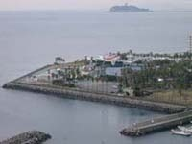
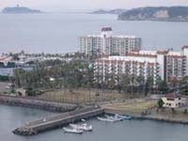
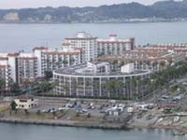
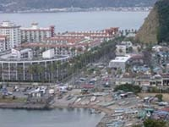
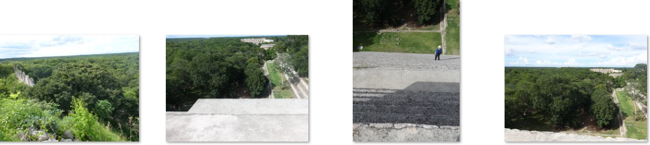
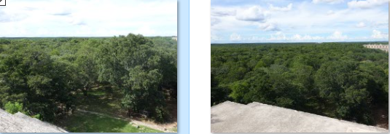
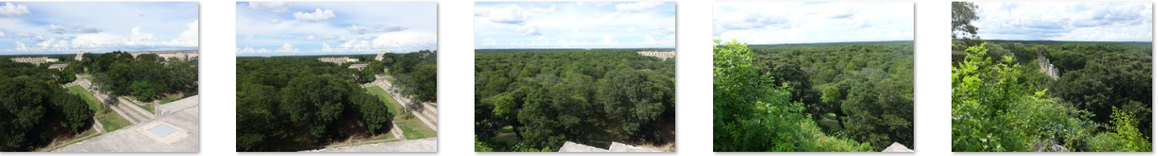
1. Take a series of interesting overlapping photos

Slide 3
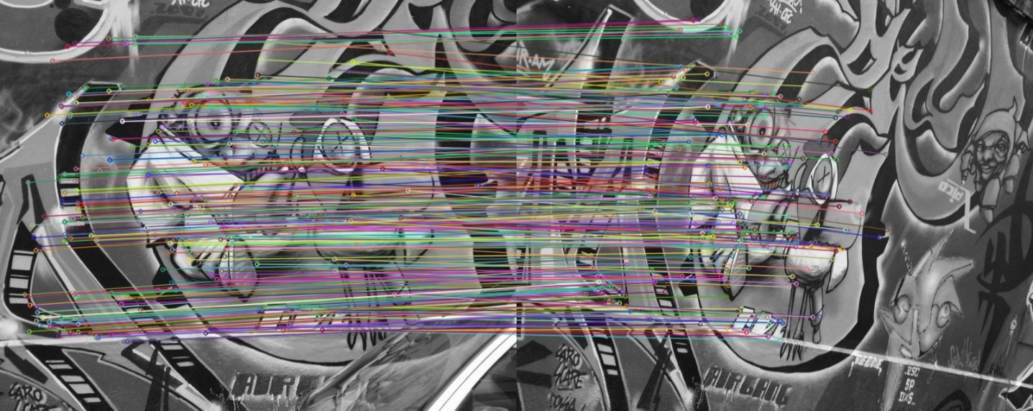
2. Detect feature points from the images and match the feature points. You can use a library function, such as AKAZE, SIFT, ORB, etc.
AKAZE https://docs.opencv.org/3.4/db/d70/tutorial_akaze_matching.html
ORB https://docs.opencv.org/4.x/d1/d89/tutorial_py_orb.html
SUPERPOINT https://github.com/rpautrat/SuperPoint
https://github.com/magicleap/SuperPointPretrainedNetwork

Slide 4

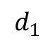
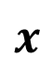
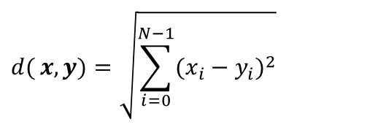
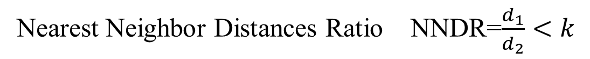
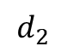
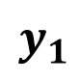
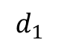
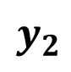
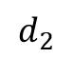
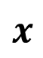
Matching strategy and error rates
$$d{(}x,y)=\sqrt{\sum_{i=0}^{N−1}{(x_{i}−y_{i})^{2}}}$$
the feature descriptor space ($N$ dim)
$$x$$
$$x$$
$$d_{1}$$
$$d_{2}$$
$$y_{2}$$
$$d_{2}$$
$$d_{1}$$
$$y_{1}$$
Nearest Neighbor Distances Ratio NNDR=$\frac{d_{1}}{d_{2}}<k$

Slide 5
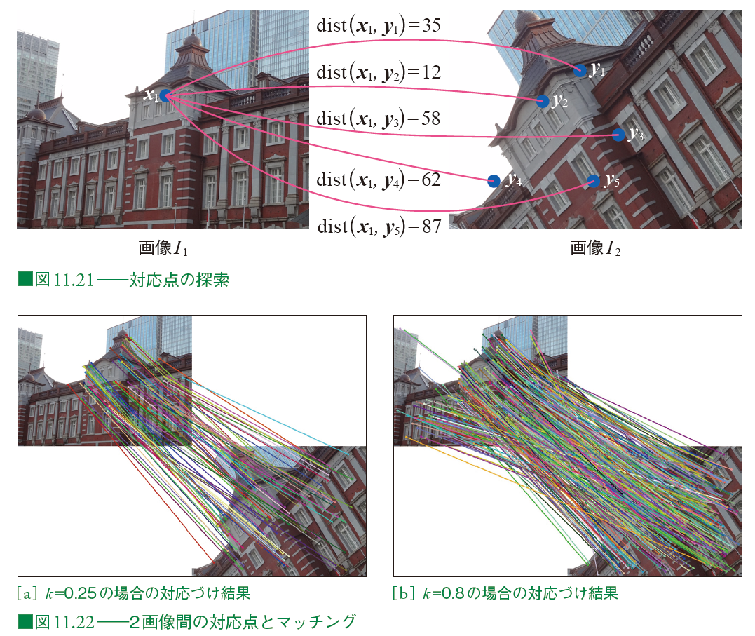

Slide 6
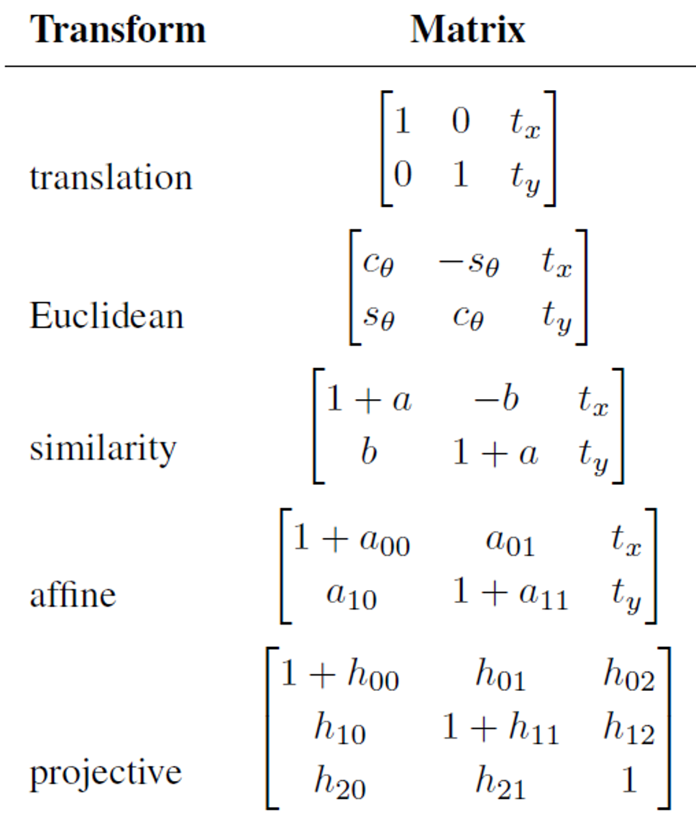
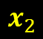

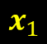
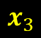



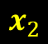
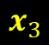

3. Assign a unique index $i$ to each track. Then you can have $\{x_{i}, y_{i}\}$ for $N$ feature points for the series of input images.
$$x_{4}$$
$$x_{4}$$
$$x_{3}$$
$$x_{3}$$
$$x_{1}$$
$$x_{2}$$
$$x_{1}$$
$$x_{2}$$
$$M$$
4. Estimate a transform for each image using the linear solution.
Homography

Slide 7
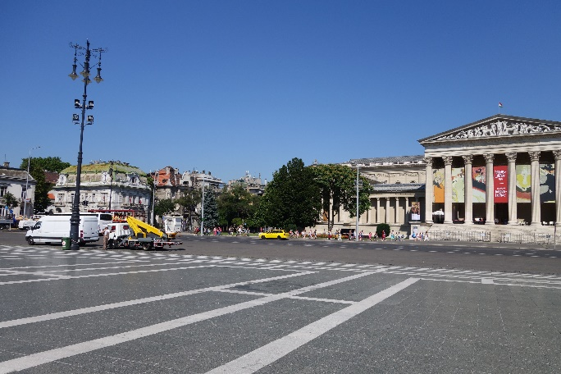
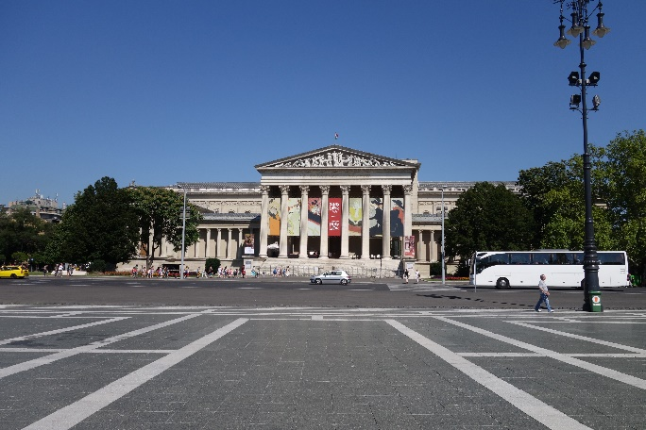
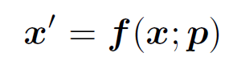
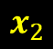
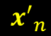
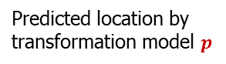
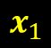
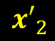
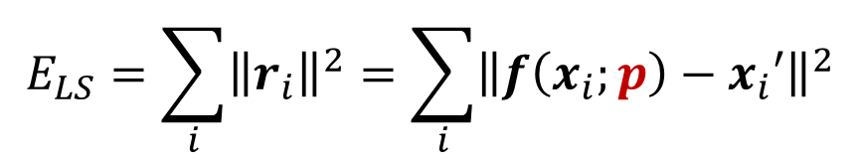

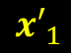

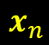
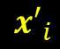
2D alignment using least squares (LS)
$$x_{n}$$
$${x′}_{i}$$
$${x′}_{n}$$
$$x_{i}$$
$$x_{1}$$
$$x_{2}$$
$${x′}_{1}$$
$${x′}_{2}$$
$$x′=f(x;p)$$
Estimate $p$by minimizing the sum of squared residuals: $E_{LS}$
$$E_{LS}=\sum_{i}{{\left\|r_{i}\right\|}^{2}}=\sum_{i}{{\left\|f\left(x_{i};p\right)−x_{i}′\right\|}^{2}}$$
Predicted location by
transformation model $p$
measurement

Slide 8

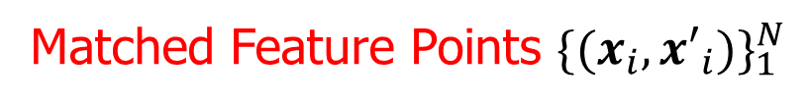
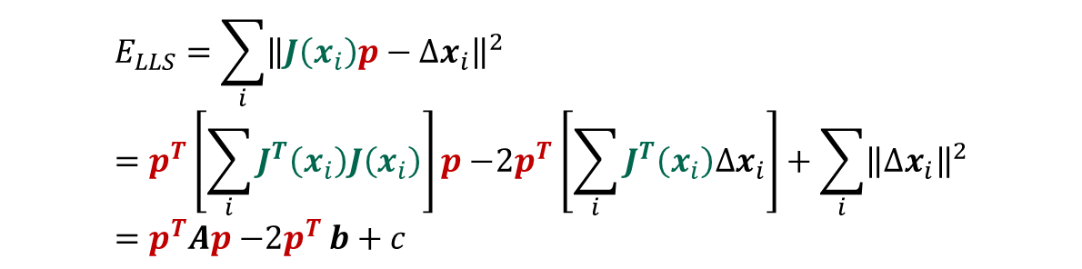

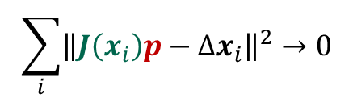
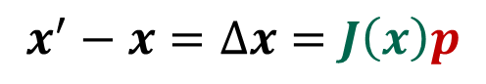
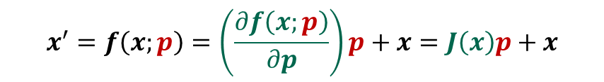
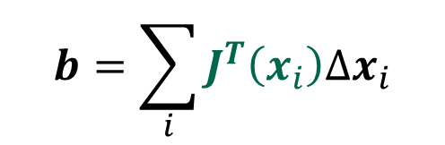
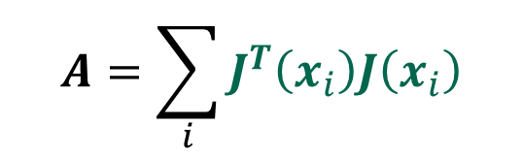
If we can assume a linear relationship between the amount of motion$Δx=x′−x$ and the unknown parameters $p$
Matched Feature Points ${\{(x_{i},{x′}_{i})\}}_{1}^{N}$
$$x^{′}=f\left(x;p\right)=\left(\frac{∂f\left(x;p\right)}{∂p}\right)p+x=J\left(x\right)p+x$$
Jacobian
$$x^{′}−x=Δx=J\left(x\right)p$$
$$\sum_{i}{{\left\|J\left(x_{i}\right)p−Δx_{i}\right\|}^{2}→0}$$
$$E_{LLS}=\sum_{i}{{\left\|J\left(x_{i}\right)p−Δx_{i}\right\|}^{2}}=p^{T}\left[\sum_{i}{J^{T}\left(x_{i}\right)J\left(x_{i}\right)}\right]p{−2p}^{T}\left[\sum_{i}{J^{T}\left(x_{i}\right)Δx_{i}}\right]+\sum_{i}{{\left\|Δx_{i}\right\|}^{2}}=p^{T}Ap{−2p}^{T}b+c$$
LLS: linear least squares
Minimum $E_{LLS}$ can be found by solving symmetric positive definite (SPD) system :
$$A=\sum_{i}{J^{T}\left(x_{i}\right)J\left(x_{i}\right)}$$
$$b=\sum_{i}{J^{T}\left(x_{i}\right)Δx_{i}}$$
$$Ap=b$$

Slide 9
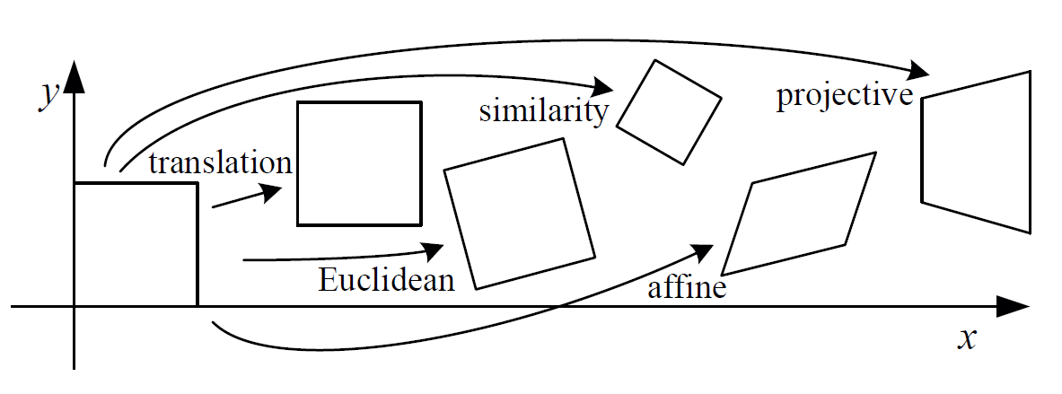
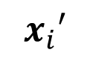
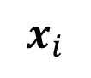
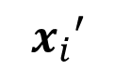
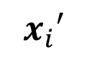



Matched Feature Points ${\{(x_{i},{x′}_{i})\}}_{1}^{N}$
$$x_{i}′$$
$$x_{i}′$$
$$x_{i}′$$
$$x_{i}′$$
$$x_{i}′$$
$$x_{i}$$

Slide 10

Jacobians of the 2D coordinate transformations
re-parameterized the motions so that they are identity I for p = 0.

Slide 11



Jacobians of the 2D coordinate transformations
Translation
$$f\left(x;p\right)=f\left(\left[\begin{matrix}x \\ y\end{matrix}\right];\left[\begin{matrix}t_{x} \\ t_{y}\end{matrix}\right]\right)=\left[\begin{matrix}x′ \\ y′\end{matrix}\right]=\left[\begin{matrix}1 & 0 & t_{x} \\ 0 & 1 & t_{y}\end{matrix}\right]\left[\begin{matrix}x \\ y \\ 1\end{matrix}\right], J=\frac{∂f}{∂p}=\left[\begin{matrix}\frac{∂x′}{∂p} \\ \frac{∂y′}{∂p}\end{matrix}\right]=\left[\begin{matrix}\frac{∂x′}{∂t_{x}} & \frac{∂x′}{∂t_{y}} \\ \frac{∂y′}{∂t_{x}} & \frac{∂y′}{∂t_{y}}\end{matrix}\right]=\left[\begin{matrix}1 & 0 \\ 0 & 1\end{matrix}\right]$$
Similarity
$$f\left(x;p\right)=f\left(\left[\begin{matrix}x \\ y\end{matrix}\right];\left[\begin{matrix}\begin{matrix}t_{x} \\ t_{y}\end{matrix} \\ \begin{matrix}a \\ b\end{matrix}\end{matrix}\right]\right)=\left[\begin{matrix}x′ \\ y′\end{matrix}\right]=\left[\begin{matrix}1+a & −b & t_{x} \\ b & 1+a & t_{y}\end{matrix}\right]\left[\begin{matrix}x \\ y \\ 1\end{matrix}\right], J=\frac{∂f}{∂p}=\left[\begin{matrix}\frac{∂x′}{∂p} \\ \frac{∂y′}{∂p}\end{matrix}\right]=\left[\begin{matrix}\begin{matrix}\frac{∂x′}{∂t_{x}} & \frac{∂x′}{∂t_{y}} \\ \frac{∂y′}{∂t_{x}} & \frac{∂y′}{∂t_{y}}\end{matrix} & \begin{matrix}\frac{∂x′}{∂a} & \frac{∂x′}{∂b} \\ \frac{∂y′}{∂a} & \frac{∂y′}{∂b}\end{matrix}\end{matrix}\right]=\left[\begin{matrix}1 & 0 & x \\ 0 & 1 & y\end{matrix} \begin{matrix}−y \\ x\end{matrix}\right]$$
Affine
$$f\left(x;p\right)=f\left(\left[\begin{matrix}x \\ y\end{matrix}\right];\left[\begin{matrix}\begin{matrix}t_{x} \\ t_{y}\end{matrix} \\ \begin{aligned}\begin{matrix}a_{00} \\ a_{01}\end{matrix} \\ a_{10} \\ a_{11}\end{aligned}\end{matrix}\right]\right)=\left[\begin{matrix}x′ \\ y′\end{matrix}\right]=\left[\begin{matrix}1+a_{00} & a_{01} & t_{x} \\ a_{10} & 1+a_{11} & t_{y}\end{matrix}\right]\left[\begin{matrix}x \\ y \\ 1\end{matrix}\right] J=\frac{∂f}{∂p}=\left[\begin{matrix}\frac{∂x′}{∂p} \\ \frac{∂y′}{∂p}\end{matrix}\right]=\left[\begin{matrix}\begin{matrix}\frac{∂x′}{∂t_{x}} & \frac{∂x′}{∂t_{y}} \\ \frac{∂y′}{∂t_{x}} & \frac{∂y′}{∂t_{y}}\end{matrix} \begin{matrix}\frac{∂x′}{∂a_{00}} & \frac{∂x′}{∂a_{01}} \\ \frac{∂y′}{∂a_{00}} & \frac{∂y′}{∂a_{01}}\end{matrix} & \begin{matrix}\frac{∂x′}{∂a_{10}} & \frac{∂x′}{∂a_{11}} \\ \frac{∂y′}{∂a_{10}} & \frac{∂y′}{∂a_{11}}\end{matrix}\end{matrix}\right]=\left[\begin{matrix}1 & 0 & x \\ 0 & 1 & 0\end{matrix} \begin{matrix}y \\ 0\end{matrix} \begin{matrix}0 \\ x \end{matrix} \begin{matrix}0 \\ y\end{matrix}\right]$$

Slide 12








Motion Alignment in Translation Case
Matched Feature Points ${\{(x_{i},{x′}_{i})\}}_{1}^{N}={\left\{\left(\left[\begin{matrix}x_{i} \\ y_{i}\end{matrix}\right],\left[\begin{matrix}x_{i}^{′} \\ y_{i}^{′}\end{matrix}\right]\right)\right\}}_{1}^{N}$
$${\{∆x_{i}\}}_{1}^{N}={\left\{\left[\begin{matrix}{x_{i}^{′}−x}_{i} \\ y_{i}^{′}−y_{i}\end{matrix}\right]\right\}}_{1}^{N}$$
$$A=\sum_{i}{J^{T}\left(x_{i}\right)J\left(x_{i}\right)}$$
$$A=\sum_{i=1}^{N}{\left[\begin{matrix}1 & 0 \\ 0 & 1\end{matrix}\right]}\left[\begin{matrix}1 & 0 \\ 0 & 1\end{matrix}\right]=\left[\begin{matrix}N & 0 \\ 0 & N\end{matrix}\right]$$
$$b=\sum_{i=1}^{N}{\left[\begin{matrix}1 & 0 \\ 0 & 1\end{matrix}\right]}\left[\begin{matrix}x_{i}^{′}−x_{i} \\ y_{i}^{′}−y_{i}\end{matrix}\right]=\left[\begin{matrix} \sum_{i=1}^{N}{(x_{i}^{′}−x_{i})} \\ \sum_{i=1}^{N}{(y_{i}^{′}−y_{i})}\end{matrix}\right]$$
$$b=\sum_{i}{J^{T}\left(x_{i}\right)Δx_{i}}$$
$$\left[\begin{matrix}N & 0 \\ 0 & N\end{matrix}\right]\left[\begin{matrix}t_{x} \\ t_{y}\end{matrix}\right]=\left[\begin{matrix} \sum_{i=1}^{N}{(x_{i}^{′}−x_{i})} \\ \sum_{i=1}^{N}{(y_{i}^{′}−y_{i})}\end{matrix}\right]$$
$$Ap=b$$

Slide 13






Motion Alignment in similarity transform
Matched Feature Points ${\{(x_{i},{x′}_{i})\}}_{1}^{N}={\left\{\left(\left[\begin{matrix}x_{i} \\ y_{i}\end{matrix}\right],\left[\begin{matrix}x_{i}^{′} \\ y_{i}^{′}\end{matrix}\right]\right)\right\}}_{1}^{N}$
$${\{∆x_{i}\}}_{1}^{N}={\left\{\left[\begin{matrix}∆x_{i} \\ ∆y_{i}\end{matrix}\right]\right\}}_{1}^{N}={\left\{\left[\begin{matrix}{x_{i}^{′}−x}_{i} \\ y_{i}^{′}−y_{i}\end{matrix}\right]\right\}}_{1}^{N}$$
$$A=\sum_{i=1}^{N}{\left[\begin{matrix}\begin{matrix}1 & 0 \\ 0 & 1\end{matrix} & \begin{matrix}x_{i} & −y_{i} \\ y_{i} & x_{i}\end{matrix} \\ \begin{matrix}x_{i} & y_{i} \\ −y_{i} & x_{i}\end{matrix} & \begin{matrix}x_{i}^{2}+y_{i}^{2} & 0 \\ 0 & x_{i}^{2}+y_{i}^{2}\end{matrix}\end{matrix}\right]}$$
$$b=\sum_{i=1}^{N}{\left[\begin{matrix}\begin{matrix}1 & 0 \\ 0 & 1\end{matrix} \\ \begin{matrix}x_{i} & −y_{i} \\ y_{i} & x_{i}\end{matrix}\end{matrix}\right]}\left[\begin{matrix}∆x_{i} \\ ∆y_{i}\end{matrix}\right]=\sum_{i=1}^{N}{\left[\begin{matrix}\begin{matrix}∆x_{i} \\ ∆y_{i}\end{matrix} \\ \begin{matrix}x_{i}∆x_{i}−y_{i}∆y_{i} \\ y_{i}∆x_{i}+x_{i}∆y_{i}\end{matrix}\end{matrix}\right]}$$
赤のところの符号が逆？
$$\left[\begin{matrix}\begin{matrix}N & 0 \\ 0 & N\end{matrix} & \begin{matrix}\sum_{i=1}^{N}{x_{i}} & −\sum_{i=1}^{N}{y_{i}} \\ \sum_{i=1}^{N}{y_{i}} & \sum_{i=1}^{N}{x_{i}}\end{matrix} \\ \begin{matrix}\sum_{i=1}^{N}{x_{i}} & \sum_{i=1}^{N}{y_{i}} \\ −\sum_{i=1}^{N}{y_{i}} & \sum_{i=1}^{N}{x_{i}}\end{matrix} & \begin{matrix}\sum_{i=1}^{N}{{x_{i}^{2}+y}_{i}^{2}} & 0 \\ 0 & \sum_{i=1}^{N}{{x_{i}^{2}+y}_{i}^{2}}\end{matrix}\end{matrix}\right]\left[\begin{matrix}\begin{matrix}t_{x} \\ t_{y}\end{matrix} \\ \begin{matrix}a \\ b\end{matrix}\end{matrix}\right]=\left[\begin{matrix}\begin{matrix}\sum_{i=1}^{N}{{Δx}_{i}} \\ \sum_{i=1}^{N}{{Δy}_{i}}\end{matrix} \\ \begin{matrix}\sum_{i=1}^{N}{x_{i}∆x_{i}−y_{i}Δy_{i}} \\ \sum_{i=1}^{N}{y_{i}∆x_{i}+x_{i}Δy_{i}}\end{matrix}\end{matrix}\right]$$
$$Ap=b$$

Slide 14
4’. Use OpenCV function for estimating homography. cv2.getPerspectiveTransform
https://www.devdoc.net/linux/OpenCV-3.2.0/da/d6e/tutorial_py_geometric_transformations.html
pts1 = np.float32([[176,187],[465,94],[98, 411],[572,356]])
pts2 = np.float32([[100,200],[500,200],[100,700],[500, 700]])
M = cv2.getPerspectiveTransform(pts1,pts2)

Slide 15




5. Compute the size of the resulting composite canvas.
6. Warp each image into its final position on the canvas. cv2.warpPerspective
dst = cv2.warpPerspective(img, M, (600, 800))

Slide 16
Stitching and Panograph
This exercise is a similar as Ex 8.2: Panography in the reference book p.549.
Panograph and stitching are both methods of combining multiple photographs to create a larger image, but with different objectives and results.
A panograph (https://edelberto-cabrera.pixels.com/featured/panograph-of-a-beach-edelberto-cabrera.html)
an artistic technique where overlapping photos are arranged in a non-linear, mosaic-like fashion, emphasizing their individual perspectives and angles, resulting in a creative, fragmented appearance.
celebrates the differences between individual photos
stitching (or photo stitching)
aims to produce a seamless, cohesive image.
aligns and blends photos carefully to ensure continuity in perspective, scale, and lighting, commonly used for panoramic images in landscape and architectural photography.
seeks to make these differences invisible.

Slide 17
Report submission
Deadline: June 2
Language: English or Japanese
Content: Goal, Method, Results, Discussion, Conclusion
Discussion
Comparison of different geometric transforms
Comparison with recent applications for stitching
https://paperswithcode.com/task/image-stitching
https://mattabrown.github.io/autostitch.html
https://www.microsoft.com/en-us/research/project/image-composite-editor/
https://paperswithcode.com/task/image-stitching

